Slide 1
Mentoring Mentors in Scientific Writing
Jonathan Fuchs, MD, MPH
Director, Center for Learning and Innovation
San Francisco Dept. of Public Health
Associate Professor of Medicine, UCSF
Director, UCSF-GIVI CFAR Mentoring Program
October 8, 2013

Slide 2
You are mentoring a new junior faculty member and are meeting her during one of your regularly scheduled one-on-one meetings.
She has been working with a post-doctoral fellow over the past 6 months on a secondary analysis from a prospective cohort study of HIV-infected individuals seen at your local clinic. The analysis is exploring correlates of non-adherence to antiretroviral therapy.
Your mentee has first-authored several papers, but hasn’t been in the position to mentor others who’ve had to write their first paper. While she has her own approach to writing, she isn’t sure her approach is the best one to impart to her fellow, and wants to know your secrets/pearls to getting papers published.
What wisdom would you like to share with your junior faculty mentee?

Slide 3
The 5 Ws (and an H) in mentoring others in paper-writing
Why we publish
Where to publish
Journal selection
Who (or with whom) to publish
Authorship
What is the structure for the article
Framework for paper writing
When to write
Timelines and getting to the end
How to communicate
With co-authors, with the journal

Slide 5
Remember why you are publishing: Altruistic reasons? Moral duty
Ethical obligation to subjects
Ethical obligation to society
Greatest public health impact
Contribute to knowledge
To really understand your topic
Notes:
5

Slide 6
Remember why you are publishing:
Selfish reasons? Duty to yourself
Documents ideas are yours
Documents your productivity
Builds your reputation as an expert
Future grant applications
Builds your career: “Publish or perish”
The “currency” of research
Notes:
6
Let’s assume for the moment that we do not have a supplement of AIDS or A&B. How do you choose a journal? Here are some things to consider:
暂时假设，我们没有与艾滋病或 A&B 有关的补充内容。你如何选择期刊杂志？你需要考虑以下问题：
Consider your field, career. Who here would say their field is not Biomed, psych, social sci? Ask, what do you consider your field? What are the leading journals in your field?
考虑你的研究领域和职业。这里有谁声称其研究领域不涉及生物医学、心理学和社会科学？你如何看待你的研究领域？你的研究领域内最知名的期刊杂志是什么？
Focus. Audience: We favor international. But really consider who needs and can find it.
关注焦点。受众：我们希望国际化。但真的会考虑谁需要且能找到它。
Competition: I favor quick acceptance over prestige.
竞争：我希望通过提高声望而被迅速接受。
Timing: I would prefer to be rejected quickly rather than have to wait. Also, some journal take a very long time even if they accept you. Quarterly, monthly, weekly.
时机：我宁愿被果断拒绝而不是等待。此外，某些期刊即使接受了你文章也要等很久才会发表。这些期刊有的是周刊，有的是月刊，还有的是季刊。
Sequence: go down in prestige. Confess, my papers are not usually accepted in first journal. My record is 6 rejections before acceptance.
结果：声望降低。不得不承认，我的文章通常不会第一次投递即被期刊杂志接受。我的记录是被拒绝 6 次后才被接受。
Note: luck, not necessarily bad paper. In fact, the paper that got rejected 6 times is still the one I had more interest in around the world. Female condoms for anal sex between men.
备注：可能是运气问题，不一定是文章写得很差。事实上，即使被拒绝6 次，我仍然对该文章很有兴趣。男性肛交所用的女性保险套。

Slide 7
The 5 Ws (and an H) in mentoring others in paper-writing
Why we publish
Where to publish
Journal selection
Who (or with whom) to publish
Authorship
What is the structure for the article
Framework for paper writing
When to write
Timelines and getting to the end
How to communicate
With co-authors, with the journal

Slide 8
To keep moving forward, know where you are going!

Slide 9
Choosing a Scientific Journal
Guiding principle: Reach the right audience
Field: Biomedical, psychological, social science, statistical
Audience: International or home country?
Focus: AIDS-focused or general audience?
Content: Clinical, epidemiological, behavioral

Slide 10
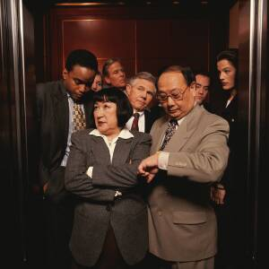
Offer a clear message
Write to the message, not the topic
What is the single most important finding
Main study aim or hypothesis
First sentence of newspaper article on your research
Elevator test

Slide 11
Elevator test in 2-3 sentences
Quick study design (how)
Quick subjects (who)
Primary results (what)
Relevance, significance of findings
Why?
The Message
Notes:
Let’s assume for the moment that we do not have a supplement of AIDS or A&B. How do you choose a journal? Here are some things to consider:
Consider your field, career. Who here would say their field is not Biomed, psych, social sci? Ask, what do you consider your field? What are the leading journals in your field?
Focus. Audience: We favor international. But really consider who needs and can find it.
Competition: I favor quick acceptance over prestige.
Timing: I would prefer to be rejected quickly rather than have to wait. Also, some journal take a very long time even if they accept you. Quarterly, monthly, weekly.
Sequence: go down in prestige. Confess, my papers are not usually accepted in first journal. My record is 6 rejections before acceptance.
Note: luck, not necessarily bad paper. In fact, the paper that got rejected 6 times is still the one I had more interest in around the world. Female condoms for anal sex between men.

Slide 12
Where should I submit?

Slide 13
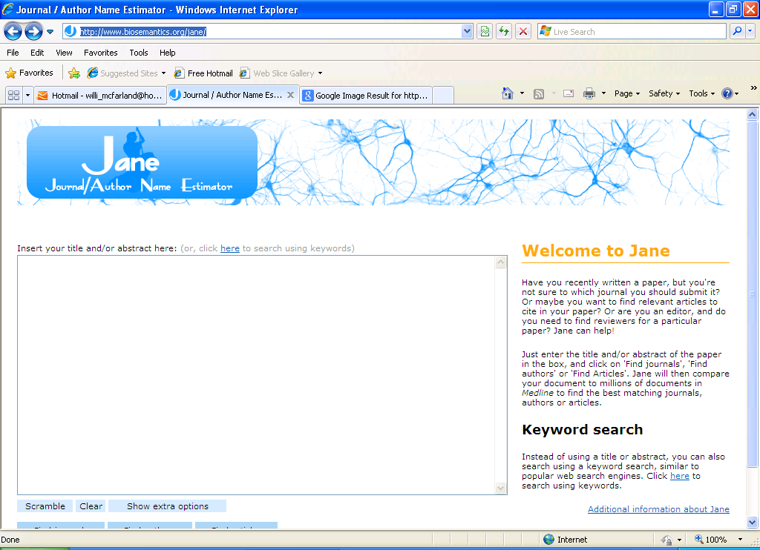
Choosing a journal using your title and/or abstract
Ask JANE!
http://www.biosemantics.org/jane/

Slide 14
Choosing a Scientific Journal
Logistical considerations
Check word count, length requirements, style guide
Full article of original research
Brief
Data letter
Letter to the editor
Timing to share your results with the world
Prestige (aim high and go lower, or sure thing?)
Open access (PloS)

Slide 15
IMPACT FACTOR
Counting references to rank the use of scientific journals.
The “impact factor ratio” is calculated as the number of citations in 1 year for all articles divided by the number of articles published in the journal in the last two years.

Slide 16
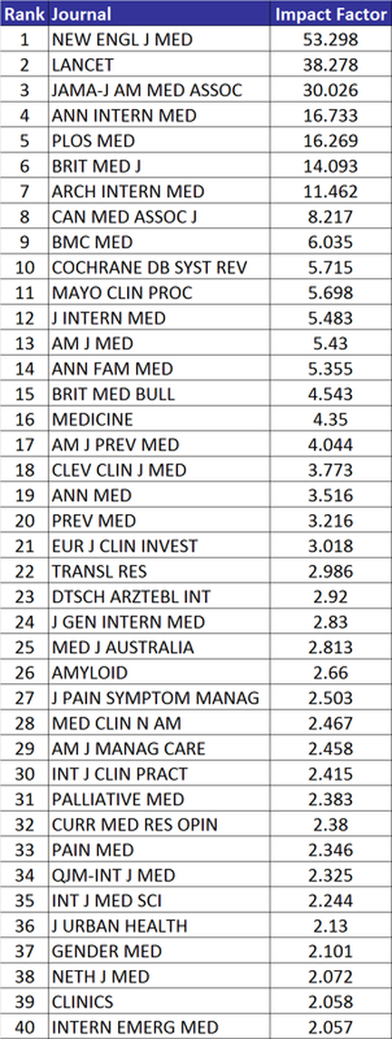
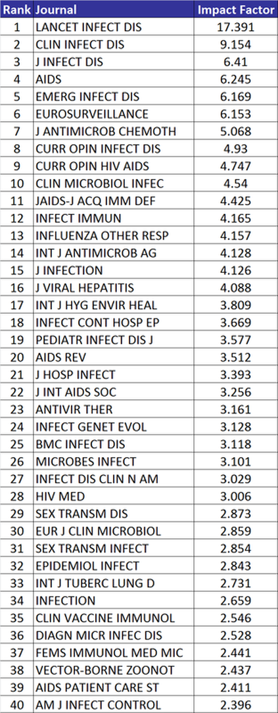
2012 General Medicine
2012 Infectious Diseases

Slide 17
Choosing a Scientific Journal: Other Messages
Guiding principle: Use any angle to get accepted
Consider sponsored supplement: AIDS
Editor seems to understand your work (they “get it”)
Luck!
Persevere – try another journal

Slide 18
The 5 Ws (and an H) in mentoring others in paper-writing
Why we publish
Where to publish
Journal selection
Who (or with whom) to publish
Authorship
What is the structure for the article
Framework for paper writing
When to write
Timelines and getting to the end
How to communicate
With co-authors, with the journal

Slide 19
Authorship
The “currency” of research
But, a source of hurt feelings
Recognition of collaborators
Cultural differences

Slide 20
Authorship
Potential problems
Omission of those who merit authorship (or should have been offered the opportunity)
Inclusion of those who do not merit authorship
Order of authorship
Clarify authorship as early as possible
But, don’t stymie productivity
If you are the research mentor, you may need to shield your mentee

Slide 21
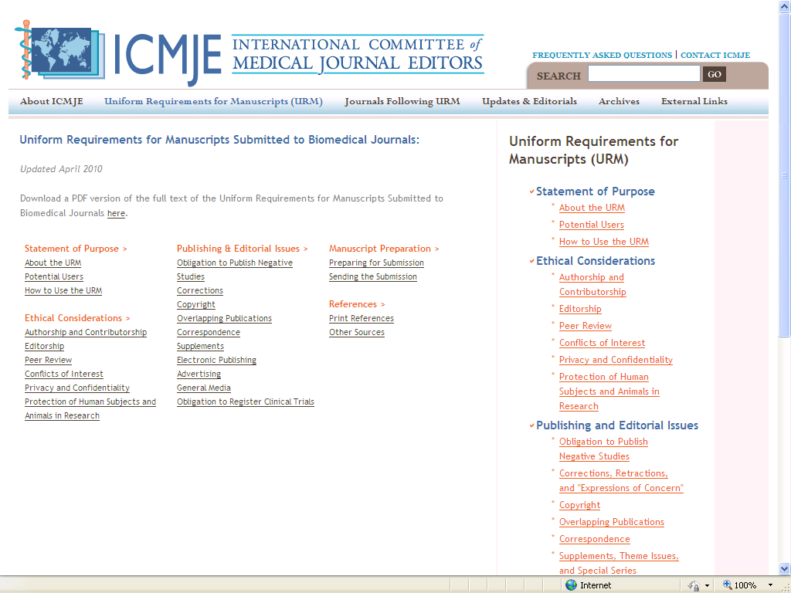
Notes:
International Committee of Medical Journal Editors
Established in 1978 in Vancouver
Established common criteria for publication of scientific articles in health
Established clear criteria for authorship in 1988

Slide 22
Authorship Criteria (JAMA)
Each author can swear, in writing:
Unique, previously unpublished
Can provide the data to publishers
Agree corresponding author can edit
Each author approves final manuscript
Each author must meet all 3 criteria:
Contributed to conception, design, analysis, or interpretation
Put pen to paper, or major editing
Provided statistical expertise, obtained funding, logistical support, or supervision
Notes:
Let’s back up on authorship. Source of recognition and hurt feelings.
Recognition, but journals are getting stricter.
Example of rules: JAMA, handout and o/h
Example of group, listed: HPI, title and list
Acknowledgements: Lindan paper

Slide 23
Authorship Rank
Best: First and *corresponding = Responsible for paper
2nd best: Last, “senior author”, PI, “grandfather of ideas”
3rd best: Second
4th best: Third, then drops off from here (only 3 authors then “et al” in many reference formats
5th best: Fourth and so on according to contribution
Worst: Next to last
Actually, there is now a “co-senior” author as next to last
*Corresponding author is responsible for paper: Can be anyone and any position - Adds prestige, but responsibility
Notes:
Run through.
Corresponding has responsibility for edit and content
Pick up examples from supplements.

Slide 24
Alternatives to Authorship
Acknowledgements
For those who do not meet authorship criteria but who contributed
Group authorship
Provides a means to add many authors
“…for the HVTN 090 Protocol Team”
All names now found in Medline
Notes:
Let’s back up on authorship. Source of recognition and hurt feelings.
Recognition, but journals are getting stricter.
Example of rules: JAMA, handout and o/h
Example of group, listed: HPI, title and list
Acknowledgements: Lindan paper

Slide 25
The 5 Ws (and an H) in mentoring others in paper-writing
Why we publish
Where to publish
Journal selection
Who (or with whom) to publish
Authorship
What is the structure for the article
Framework or formula for paper writing
When to write
Timelines and getting to the end
How to communicate
With co-authors, with the journal

Slide 26
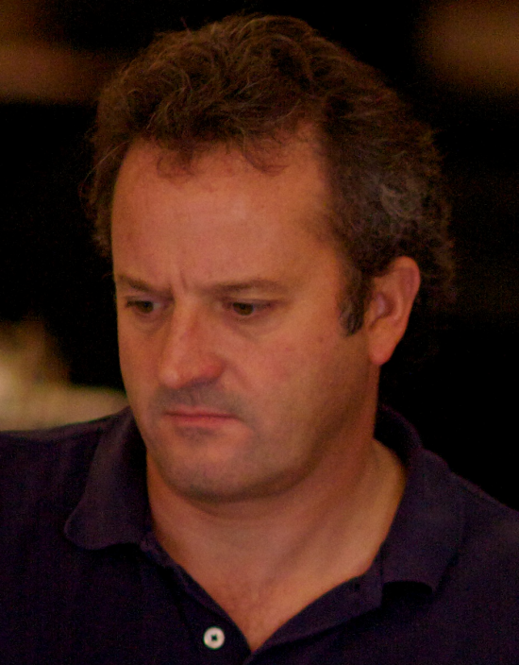
Acknowledgement
18 years
288 students
Over 228 publications using this formula (and counting…)
Willi McFarland, MD, PhD

Slide 27
Tip: Do not compose you paper in the conventional order
Abstract
Introduction
Methods
Results
Discussion
References
Tables and Figures

Slide 28
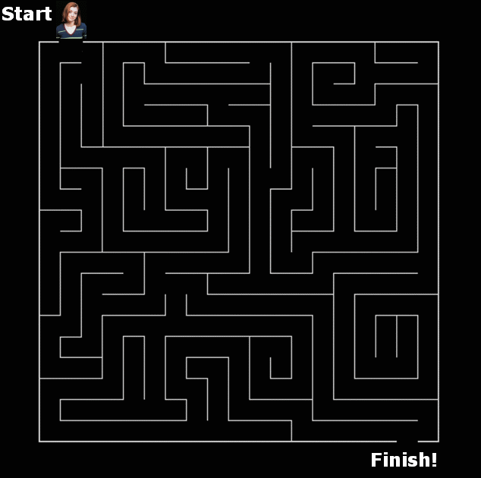
Start at the end, work towards the start
Easier to get started if you know where you are going
Easier to pose the question if you know the answer
Notes:
28

Slide 29
Find the message and compose backwards from it
Tables and Figure
Results
Discussion
Introduction
Methods
Abstract
References

Slide 30
Rule of 4

Slide 31
4 x 4
3. Results
Trust me
Cool measures
No tricks
It’s solid
4. Discussion
Mission accomplished!
Not only that...
Mea culpa
Kumbaya
4 also as 3 Tables and 1 Figure
1. Introduction
Big Picture
Specific Issue
Gap in knowledge
How we fill the gap
2. Methods
Overall study design
Study subjects
Measures
Analysis

Slide 32
Tables and Figures

Slide 33
Tip: Pass the “Fall on the Ground Test”

Slide 34
Tables and Figures
3 tables
Table 1. Description of study population
Table 2. Bivariate correlates of main outcome
Table 3. Multivariate analysis of main outcome
(Table 4 maybe. Sub-analyses, secondary questions)
1 figure (maybe)
Figure 1. Flow of subjects (e.g., CONSORT Diagram); procedures in study; trends over time; Map; “Cascade”

Slide 35
Results

Slide 36
Results in 4 Parts
Trust us: Describe your sample (Table 1)
This is a great sample, the right population, here is how it may or may not look like your population
Eligible, enrolled, participation rate
Demographics
Cool measures: Primary outcomes (Table 1 or 2)
Segue to the most novel and interesting measures
Main outcome, other outcomes, laboratory results, novel measures

Slide 37
Results in 4 Parts
No tricks: Associations with the main outcome clear on the face of it (Table 2 or 3)
Bivariate analysis
Maybe Figure showing main effect (bivariate)
Pivotal result, make your case crystal clear
It’s solid: The effect holds up to adjustments (Table 3 or 4)
Multivariate analysis, confouding, complex weighting
May need statistical consultation or co-investigator

Slide 38
Results
Say in words what the tables and figure say in numbers (highlight salient story)
Follow the sequence of tables and figures
Go back and forth to get the order exactly the same
State in words the most interesting findings in table
Not all numbers: key characteristics of sample, main outcomes, most important, unexpected
Non-significant findings if relevant

Slide 39
Additional Tips for Results
OK to be short
Just the facts of your data
Compare within your data, not to other studies
No references
Interpret data points as facts - not the meaning, importance, context

Slide 40
Discussion

Slide 41
The Discussion Section
The meaning, the importance, and context of the facts
Highlights the health impact of the study
This is the most creative part
Opportunity to share your ideas
Most prone to writer’s block

Slide 42
Template for Discussion in 4 parts
Mission accomplished!
The elevator test
Not only that…
Other, unexpected, secondary findings
Mea culpa
Limitations
But, redemption!
Kumbaya
Public health implications, way forward

Slide 43
Mission Accomplished!
With the tables/figures, may be the only thing your audience reads
The message: “Elevator Test”
Your primary research question
The answer to the question posed in the introduction (or in title)
The first sentence of Discussion
“We found…”
“Our study shows…”
“Our study provides evidence that…”
Notes:
Ask someone else to try.
Try for someone else.

Slide 44
Not only that…
Relax, now that the message was delivered
3 or so additional interesting findings and their meaning
Unexpected findings (We love these!)
Contradict other studies, conventional wisdom
Disproves your own biases!
Notes:
Ask someone else to try.
Try for someone else.

Slide 45
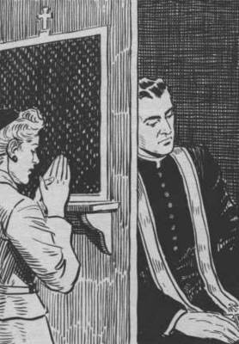
Mea Culpa
“We recognize limitations of our study…”
Confess!
No study is without potential bias
No study is perfectly executed
Head off criticism
Redemption now possible!
Notes:
Ask someone else to try.
Try for someone else.

Slide 46
Mea Culpa
Start with biggest bias or threat to internal validity
Proceed to next most important, and so on
Notes:
Ask someone else to try.
Try for someone else.

Slide 47
Mea Culpa… and Redemption!
How you did your best to address the bias in the design and analysis
Other evidence that bias is not likely to change your primary conclusion (message is solid!)
Evidence of other studies
How you avoided biases of other studies
Notes:
Ask someone else to try.
Try for someone else.

Slide 48
Kumbaya
Notes:
Ask someone else to try.
Try for someone else.

Slide 49
Kumbaya
Don’t end on a negative!
Human nature likes the positive
Science is incremental improvement
Notes:
Ask someone else to try.
Try for someone else.

Slide 50
Kumbaya
Segue from Mea Culpa “Despite potential limitations…”
Way forward
Public health and clinical implications
Setting the future research agenda
Notes:
Ask someone else to try.
Try for someone else.

Slide 51
Introduction

Slide 52
Introduction
Write to the message, not the topic
Pose a question: Easier to pose the question you already answered
There are infinite unanswered questions
Exhaustive literature searches are a source of procrastination, or insecurity (15 to 20 total is enough!)
You need a filter to get the focus

Slide 53
Introduction in 4 parts
Think 4 sentences:
General situation (known)
Specific topic (known)
Gap in our knowledge of the topic (unknown – but your message fills it!)
What you did to fill the gap

Slide 54
Example of 4 sentence introduction
General:
The movement of people has contributed to the spread of infectious diseases
Specific:
Truck drivers in Africa have particularly been implicated in the dissemination of HIV
Gap:
Few studies have been done on truck drivers in Brazil
How we filled the gap:
We conducted a survey of truck drivers at a major cross roads in Northeastern Brazil

Slide 55
Methods
How you did the study with enough detail for the reader to judge whether the findings you report support your conclusions (message)
No less
No more
Not a protocol!

Slide 56
Methods in 4 parts
Points to communicate = headings:
Study design (cross-sectional, longitudinal, RCT)
Subjects (setting, target populatoin, eligibility, sampling, recruitment)
Measurements (behavioral, laboratory)
Analysis (statistics)
Ethics statement

Slide 57
4 x 4
3. Results
Trust me
Cool measures
No tricks
It’s solid
4. Discussion
Mission accomplished!
Not only that...
Mea culpa
Kumbaya
4 also as 3 Tables and 1 Figure
1. Introduction
Big Picture
Specific Issue
Gap in knowledge
How we fill the gap
2. Methods
Overall study design
Study subjects
Measures
Analysis

Slide 58
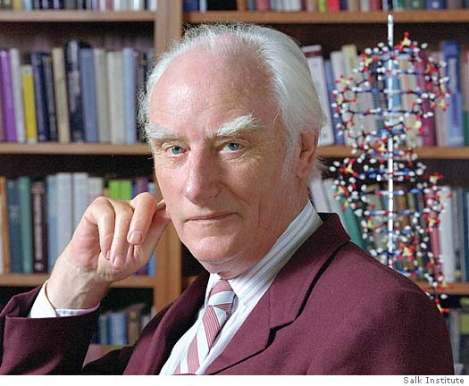
Scientific Writing Reflections: Summing Up
There is no form of prose more difficult to understand and more tedious to read than the average scientific paper. Francis Crick, The Astonishing Hypothesis, 1994

Slide 59
Journals Regularly Plead for Clarity
The infectiousness of pompous prose.
Nature, 1992.
In pursuit of comprehension.
Nature, 1996.
Evidence-based illiteracy: time to rescue "the literature".
The Lancet, 2000.
Compliance (COMmunicate PLease wIth Less Abbreviations, Noun Clusters, and Exclusiveness).
Am. J. Respir. Crit. Care Med., 2002.
Clear as mud.
Nature, 2003.

Slide 60
Tips from my English teacher
Be concise
To write well is to re-write shorter
No unnecessary words
Have non-experts read your work
Grant, Right your Writing, The Scientist

Slide 61
The 5 Ws (and an H) in mentoring others in paper-writing
Why we publish
Where to publish
Journal selection
Who (or with whom) to publish
Authorship
What is the structure for the article
Framework or formula for paper writing
When to write
Timelines and getting to the end
How to communicate
With co-authors, with the journal

Slide 62
When to write
Are 3 hour blocks to write necessary? Will 30 minutes do?
Write in an environment that works for you
Save a relatively easy paragraph to write in the morning

Slide 63
The 5 Ws (and an H) in mentoring others in paper-writing
Why we publish
Where to publish
Journal selection
Who (or with whom) to publish
Authorship
What is the structure for the article
Framework or formula for paper writing
When to write
Timelines and getting to the end
How to communicate
With co-authors, with the journal

Slide 64
Communicating with co-authors (and you)
Set up a schedule with key milestones and communicate to co-authors
Define roles early on
Who is drafting which sections?
Lead author drafting full manuscript or are sections distributed, or combination thereof?
How many rounds of reviews?
Including your edits/suggestions
For Network or Consortia-based papers, what time for central review may be required? Sponsor review?

Slide 65
Communicating with the Journal

Slide 66
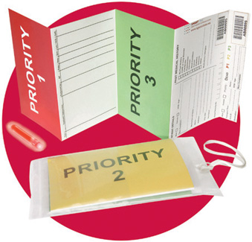
Selling yourself: you must get through “triage”
Editorial Triage
Does this article have a clear message?
Is it original?
Is it important?
Is it true?
Is it relevant to our readers?
Gavin Yamey, UCSF

Slide 67
The first thing an editor looks at is… the Title
Don’t waste this 1st chance to sell yourself
Entice the reader
Concise, informative
Expository, declarative, a question
Not overly sensationalized

Slide 68
The second thing an editor looks at is…cover letter
Terrific opportunity to “sell” your work
Don’t write something dull
“Please consider this manuscript for publication in your esteemed journal”
Do tell the editor why they really should take your work seriously
“We have done the first ever RCT to assess whether drug x can limit neurocognitive decline in patients with dementia”
cover
letter

Slide 69
The third thing an editor looks at is… abstract
Important fact: many journals now base their initial decisions on your abstract alone
Yet many authors write the abstract in a great rush
Concise, “stand alone” piece, clear message
Must reflect the full paper
Why did you do the study? What did you do? What did you find? What did you conclude? (conclusions only for results presented)

Slide 70
Overview of Peer Review Process
Paper Submitted
Notification to Author
Confirmation of Receipt
Revise
Accept
Initial Decision by Editor
Revision Received
Rejection
Decide to Review
Revision Checked
Assign Reviewers
Reviewers Accept Invite
Reviews Completed
Paper sent to Publisher
Revise
Accept
Reject

Slide 71
The 5 Ws (and an H) in mentoring others in paper-writing
Why we publish
Where to publish
Journal selection
Who (or with whom) to publish
Authorship
What is the structure for the article
Framework for paper writing
When to write
Timelines and getting to the end
How to communicate
With co-authors, with the journal

Slide 72
Don’t get discouraged!

Slide 73
Keep things moving forward!

Slide 74
Questions? Comments?

